Slide 1
WEEK 28
Imitation Learning
R1 learns to mimic the retargeted tennis motion
video -> GVHMR -> GMR -> imitation learning -- the last arrow is this week's work

Slide 2
The pipeline
Four stages. Three were done before this week.
1. Video
2. GVHMR
3. GMR
4. IL Training
a phone/demo clip
of a human moving
video -> SMPL-X
human kinematics
SMPL-X -> R1
joint trajectories
R1 motion data ->
a trained policy
DONE
DONE
DONE
THIS WEEK
GVHMR+GMR were ported to this workstation last week (~11x/2.6x faster than the laptop, numbers matched within noise). This week: pick a training framework, wire up R1, train, and check the result both natively and via an independent sim2sim harness.

Slide 3
THE CHOICE
Which framework?
GMR's output is designed to feed straight into one of three published training codebases
TWIST, BeyondMimic, or ASAP -- picked before writing a line of training code

Slide 4
Three candidates, one hardware reality
This RTX 5080 (Blackwell) has already broken two Isaac-family stacks this project
Framework
Physics engine
Blackwell / WSL2 risk
R1 support
TWIST
IsaacGym (train)
Confirmed broken -- NVIDIA forum: IsaacGym Preview 4
missing SM_120 kernels on RTX 5080, deprecated, no fix
No R1 path -- hardcoded to G1
BeyondMimic
(original)
Isaac Lab / Isaac Sim
High risk -- same GPU-PhysX hang this project
already hit and worked around with device="cpu"
G1-focused, modular robot dirs
BeyondMimic
via mjlab
MuJoCo-Warp
(no Isaac at all)
Low risk -- pure CUDA compute, no rendering
stack; matches what already works here
Data-driven robot configs -- comparable
lift to the GMR R1 work already done
ASAP
IsaacGym / IsaacSim
/ Genesis (pick one)
Medium -- every backend shares some version
of the same risk; Genesis untested here
No native R1, but a retargeting path that
overlaps with GMR work already done

Slide 5
Why BeyondMimic via mjlab
Structurally avoids a failure class this project already hit twice on this exact GPU: Isaac Sim's GPU-PhysX pipeline hang, and now IsaacGym's outright SM_120 incompatibility.
Trains headless on pure CUDA compute (MuJoCo-Warp) -- no rendering/PhysX stack at all, matching this machine's actual proven-working profile (CUDA yes, GL/Vulkan no).
Most actively maintained of the four: 3.1k stars, 1,115 commits, active CI.
It's a direct, source-linked reimplementation -- mjlab's own tracking_env_cfg.py header reads:
"This is a re-implementation of BeyondMimic. Based on HybridRobotics/whole_body_tracking,
commit f8e20c880d9c8ec7172a13d3a88a65e3a5a88448"
Adding R1 means writing a data-driven robot config -- comparable effort to the R1-into-GMR work already finished, not a new research problem.

Slide 6
SETUP
Wiring it up
Verify Blackwell works, add R1 to mjlab, connect WandB
three real blockers hit along the way -- covered honestly, not glossed over

Slide 7
Step 1 -- verify the GPU path before building anything
mjlab needs an NVIDIA GPU for training (MuJoCo-Warp, GPU-accelerated compute). Before writing any R1-specific code, confirm this Blackwell card actually runs a real GPU tensor op through the exact torch build mjlab uses.
python -c "import torch; torch.cuda.get_device_capability(0)"
torch: 2.7.0+cu128
cuda available: True
device: NVIDIA GeForce RTX 5080
capability: (12, 0)
matmul ok, sum: -39756.55078125
capability (12, 0) = Blackwell sm_120, and a real matmul executed on-device. torch 2.7.0+cu128 is the confirmed-working build for this card (already established porting GVHMR last week).

Slide 8
Step 2 -- add R1 as a real robot inside mjlab
Not a config file -- mjlab's robots are code (asset_zoo/robots/<name>/)
What had to be written
uv run python -c "... build Entity, Scene, Simulation ..."
R1 tasks registered: ['Mjlab-Tracking-Flat-Unitree-R1',
'Mjlab-Tracking-Flat-Unitree-R1-No-State-Estimation']
SCENE BUILT AND INITIALIZED OK on cuda:0
num joints: 24 num bodies: 25
asset_zoo/robots/unitree_r1/r1_constants.py
- MJCF path (reused GMR's clean 24-joint
R1 model -- no phantom joints)
- PD gains: taken from this project's own
r1_stand_sim2sim.py deployment values,
NOT a G1-analogy guess
- Effort limits: official Unitree R1_C++.xml
ctrlrange (88/139/50/25 Nm)
- Stand keyframe: the validated Goal-1 pose
tasks/tracking/config/r1/
- env_cfgs.py, rl_cfg.py (mirrors G1's)
- registered as Mjlab-Tracking-Flat-Unitree-R1
Every number is sourced, not guessed
PD gains: real deployment values (r1_stand_sim2sim.py).
Effort limits: real motor specs (R1_C++.xml).
Stand pose: the already-validated Goal-1 pose.
Only the joint-limit/armature default is a MuJoCo
generic (0.01) -- no per-motor rotor-inertia sheet
exists for R1 the way it does for G1.

Slide 9
What is Weights & Biases, and why does training need it?
What it is
Why this project needs it (not optional)
A hosted experiment-tracking service: it logs training
curves, hyperparameters, and files ("artifacts") to a
web dashboard in real time, and stores them in an
account-scoped "Registry" that any later run can pull
back by name.
BeyondMimic (and mjlab's reimplementation) uses WandB
not just for logging, but as the actual storage/lookup
mechanism for reference motions: a converted motion
file gets uploaded once, then any training run just
asks for it by name.
csv_to_npz.py auto-uploads the converted GMR motion
to a WandB registry as part of the conversion step.
The train command then pulls the motion back by
--registry-name <org>/wandb-registry-motions/r1_tennis
-- there is no "just point it at a local file" path in
this framework's design.
Real blocker hit: WandB registries can only be created
through the web UI, never the API -- had to walk
through creating one by hand before training could
start at all.

Slide 10
The motion, converted and registered
GMR's output pickle (root_pos, root_rot, dof_pos -- already MuJoCo qpos-shaped) is converted to the CSV mjlab expects, then run through csv_to_npz.py, which replays it through forward kinematics and pushes the result to the WandB registry.
uv run python -m mjlab.scripts.csv_to_npz --input-file tennis.csv --robot r1 ...
Motion interpolated, input frames: 312, input fps: 30.0, output frames: 519, output fps: 50.0
Processing frames: 100%|##########| 519/519 [00:01<00:00, 327.85 frame/s]
wandb: setting up run 42fiawyz
wandb: Syncing run r1_tennis
Stacking arrays and saving data...
Saving to /tmp/motion.npz...
Uploading to Weights & Biases...
[INFO]: Logging motion to wandb: r1_tennis
[INFO]: Motion saved to wandb registry: motions/r1_tennis

Slide 11
THE CODE
Section by section
What each piece of the R1 tracking config actually does
r1_constants.py (the robot) + env_cfgs.py (the task)

Slide 12
r1_constants.py -- the robot
Every section, what it's for
MJCF + get_spec()
Points at the GMR-clean R1 model (24 real joints, no phantom waist_pitch/wrist_pitch/wrist_yaw). get_spec() returns a fresh mujoco.MjSpec each call.
Actuator configs (7 groups)
One BuiltinPositionActuatorCfg per joint-torque class. Each sets stiffness, damping, effort_limit -- turns a kinematic joint into a controlled one.
STAND_KEYFRAME
The robot's pose and height at episode reset -- reused verbatim from the already-validated Goal-1 standing pose, not re-derived.
FULL_COLLISION
Which geoms can touch what, and with what friction/priority -- feet get condim=3 (real contact), everything else condim=1 (self-collision only).
get_r1_robot_cfg()
Assembles all of the above into one EntityCfg. Returns a fresh instance every call -- mjlab explicitly warns against sharing one across environments.
R1_ACTION_SCALE
Computed, not chosen: 0.25 * effort_limit / stiffness per joint -- this is what converts the policy's raw network output into a joint position offset.

Slide 13
env_cfgs.py -- the tracking task
unitree_r1_flat_tracking_env_cfg()
scene.entities
{"robot": get_r1_robot_cfg()} -- plugs the R1 config from the previous slide into the shared BeyondMimic tracking environment (make_tracking_env_cfg()).
self_collision sensor
A ContactSensorCfg watching the pelvis subtree against itself -- feeds the self_collisions reward term and the training curves' collision metric.
joint_pos_action.scale
Set to R1_ACTION_SCALE -- without this the action-to-target conversion would silently use whatever the shared default is, not R1's real gains.
motion command anchor/body_names
anchor_body_name="torso_link"; 14 tracked bodies (pelvis, hips, knees, ankles, torso, shoulders, elbows, wrists). R1 has no wrist_yaw_link (phantom joint) -- wrist_roll_link stands in as the real last arm body.
foot_friction / base_com events
Domain-randomization event configs re-pointed at R1's real geom/body names (left|right)_foot[1-7]_collision and torso_link.
ee_body_pos termination
Ends an episode early if a tracked end-effector (ankles, wrists) drifts too far from the reference -- the actual signal behind "Episode_Termination/anchor_pos" in the training curves.

Slide 14
TRAINING
3,000 iterations, 4,096 envs
~1 hour on the RTX 5080, measured, not estimated
a 100-iteration benchmark set the estimate before committing to a real run

Slide 15
Training spec
What was actually run, and where each number comes from
Episode length
10.0 s
tracking_env_cfg.py default -- one full pass of a ~10s motion clip
Control rate
125 Hz
physics dt 0.002s x decimation 4
Parallel environments
4,096
measured via a 100-iter benchmark first: ~1.1s/iteration, 82-100k steps/sec on this GPU
Steps per env per iteration
24
rl_cfg.py num_steps_per_env
PPO epochs / mini-batches
5 / 4
rl_cfg.py -- standard PPO inner-loop settings
Learning rate
1e-3, adaptive (target KL 0.01)
rl_cfg.py
gamma / GAE lambda
0.99 / 0.95
rl_cfg.py
Total iterations
3,000
a deliberately conservative first real attempt, not the framework's 30,000 default (which is tuned for general G1 locomotion, not one short clip)
Wall-clock time
59:15
measured -- matches the ~1hr estimate from the benchmark

Slide 16
Reading the training curves
What each number represents, and what's an acceptable range
Mean reward (-0.95 -> +27.04)
Sum of all weighted reward terms. Negative = mostly failing early; the sign flip to strongly positive is the clearest single convergence signal.
error_joint_pos (2.56 -> 1.16 rad)
L2 norm across all 24 joints vs the reference pose. Lower is better; this run's final value is still a first-pass number, not a converged floor.
error_body_pos (0.17 -> 0.068 m)
Mean tracked-body position error (14 bodies). Sub-10cm is a reasonable "looks right" threshold for this robot's scale.
Episode_Termination/anchor_pos (4-17 -> 0.0)
How many envs per batch fell/diverged far enough from the reference to end early. Zero means the policy stopped falling over.
Episode_Termination/time_out (2-6 -> 8.6)
How many envs instead survive to the full 10s episode. This flipping to dominate is the real "it's tracking now" signal.

Slide 17
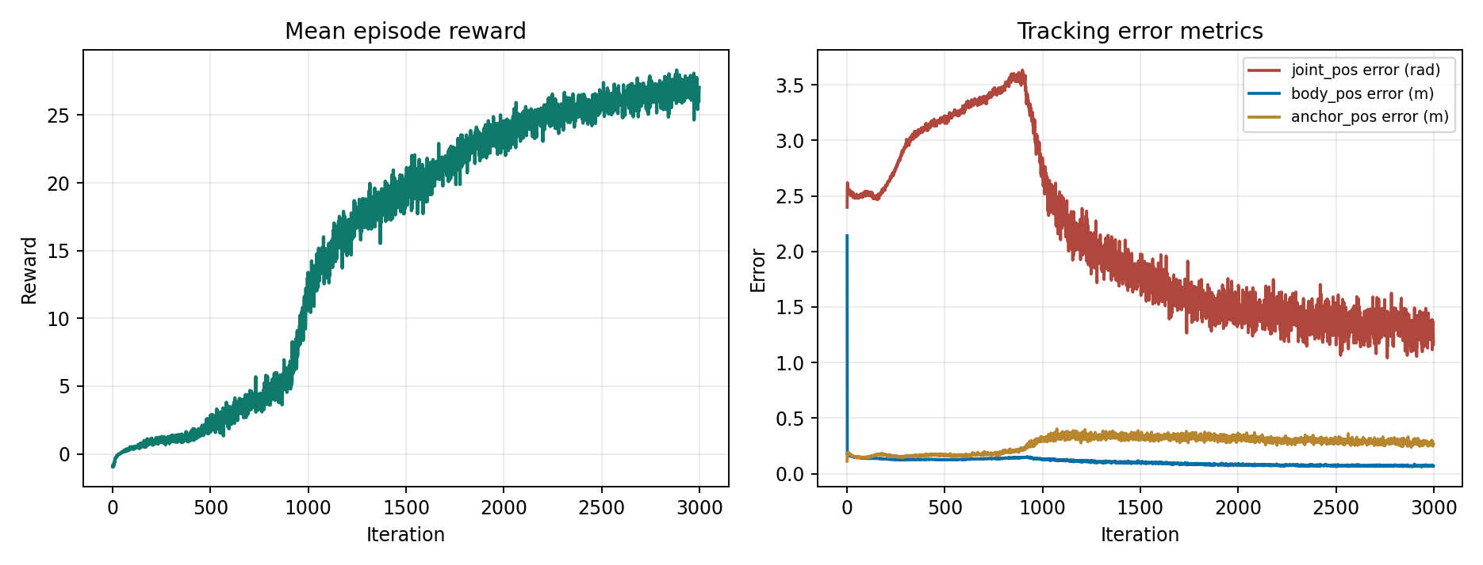
The training curves
real TensorBoard data from this run, not illustrative
Left: mean episode reward. Right: three tracking-error metrics, all trending down. 3,000 iterations was a first real attempt, not a claim of full convergence.

Slide 18
Start and end of the run, verbatim
iteration 1/3000
iteration 2999/3000
Learning iteration 1/3000
Run name: r1_tennis_run1
Total steps: 196608
Steps per second: 78501
Mean reward: -0.85
Mean episode length: 14.24
Episode_Reward/motion_body_pos: 0.0235
Metrics/motion/error_anchor_pos: 0.1872
Metrics/motion/error_body_pos: 0.1691
Metrics/motion/error_joint_pos: 2.5631
Episode_Termination/time_out: 2.2500
Episode_Termination/anchor_pos: 17.4583
Learning iteration 2999/3000
Run name: r1_tennis_run1
Total steps: 294912000
Steps per second: 70226
Mean reward: 27.04
Mean episode length: 480.49
Episode_Reward/motion_body_pos: 0.9012
Metrics/motion/error_anchor_pos: 0.2649
Metrics/motion/error_body_pos: 0.0679
Metrics/motion/error_joint_pos: 1.1612
Episode_Termination/time_out: 8.6250
Episode_Termination/anchor_pos: 0.0000
--------------------------------------------------------------------------------
Iteration time: 1.40s Time elapsed: 0:59:15 ETA: 0:00:00

Slide 19
Checking it natively before trusting the video
mjlab's own evaluate.py -- 64 held-out episodes, real metrics
uv run python -m mjlab.tasks.tracking.scripts.evaluate ... --num-envs 64
[INFO] Running 64 evaluation episodes...
[INFO] 64/64 episodes completed (step 499, truncated=62, terminated=0)
==================================================
Evaluation Results
==================================================
success_rate: 0.9688
mpkpe: 0.2991
r_mpkpe: 0.0637
joint_vel_error: 1.1492
ee_pos_error: 0.0870
ee_ori_error: 0.2632
==================================================
96.9% success rate (62/64 episodes survive to timeout). mpkpe (mean per-keypoint position error) 0.30m, end-effector position error 8.7cm -- the policy genuinely tracks the motion, not just a training-curve artifact.

Slide 20
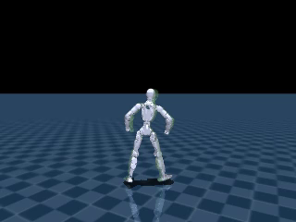
The result
checkpoint model_2999, played back in mjlab's own simulator
R1 tracking the retargeted tennis motion after 3,000 training iterations

Slide 21
SECOND MOTION
Does this generalize?
Everything so far used one clip -- GVHMR's own tennis demo
sourced a fresh video from the open web, same session, no changes to the pipeline

Slide 22
Finding a video -- and a lesson in not trusting descriptions
Wanted something more dynamic than tennis: a dance clip, full body, plain background, static camera (matches what made the tennis demo clip work well). Searched free stock video sites -- but a page's own description of a clip is not the same as looking at it.
finding a usable clip
Candidate 1: "A Person Dancing" (Pexels, cyberpunk/neon)
-> checked actual decoded frame: full body, but dark, cluttered background
Candidate 2: "Woman Dancing" (Pexels, studio) -- page said "full-body performer"
-> checked actual decoded frame at t=0: tight crop, legs and feet only
-> REJECTED -- page description was wrong
Candidate 3: "Woman Dancing" by Antoni Shkraba (Pexels, studio)
-> checked poster JPG before downloading: full body, plain background,
static camera, mid-dance-move -- confirmed good, downloaded (26.5s, 25fps)
Candidate 2's page said "full-body performer" -- the actual decoded frame showed a tight crop of just legs and feet. Lesson: pull the real poster image or a decoded frame before downloading, every time.

Slide 23
Same pipeline, new motion
no code changes -- GVHMR -> GMR -> mjlab, first attempt
GVHMR + GMR retarget, real output
native evaluate.py -- dance vs tennis
[Input]: docs/example_video/dancer.mp4
(L, W, H) = (662, 2160, 4096)
[Preprocess] End. Time elapsed: 99.89s
[HMR4D] Predicting
[HMR4D] Elapsed: 1.03s for data-length=22.1s
[headless] dancer/hmr4d_results.pt: 662 frames, human height ... (from betas[0])
[ground] mode=linear: ...
[headless] IK solve rate: 305.4 FPS (2.2s for 662 frames), motion is 30 fps -> real-time capable
[headless] motion saved to out/dancer_r1.pkl
[INFO] Running 64 evaluation episodes...
[INFO] 64/64 episodes completed (step 499, truncated=64, terminated=0)
==================================================
Evaluation Results
==================================================
success_rate: 1.0000
mpkpe: 0.2195
r_mpkpe: 0.0818
joint_vel_error: 1.5615
ee_pos_error: 0.1329
ee_ori_error: 0.6138
==================================================
Mean reward
Tennis: -0.95 -> 27.04
Dance: -0.61 -> 26.81
Native success_rate
Tennis: 0.9688
Dance: 1.0000
mpkpe
Tennis: 0.2991
Dance: 0.2195

Slide 24
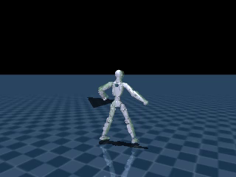
The result, again -- on a motion the pipeline had never seen
checkpoint model_2999, 3,000 iterations, first attempt
R1 tracking the freshly-sourced dance motion -- 100% native success rate

Slide 25
SIM2SIM
Does it survive a different engine?
Native training used MuJoCo-Warp (GPU-batched). Does the policy still work in plain MuJoCo?
reported honestly: real bug found and fixed, one divergence still open

Slide 26
Sim2sim, honestly
what this actually means and what happened
This project's established meaning of sim2sim: train in one simulator, deploy in a genuinely different one, and see if the policy survives. mjlab trains on MuJoCo-Warp (GPU-batched); the test here is plain single-instance MuJoCo (CPU, mj_step) driving the exported ONNX policy directly -- a real second physics engine implementation, not a device-flag change.
What made this tractable
What was found (see next slide for the full arc)
The exported ONNX is self-describing: joint order,
PD gains, effort limits, default pose, and action
scale are all embedded as metadata -- read directly
off the file, not re-derived by hand. This removed
most of the observation-reconstruction risk.
The official companion sim2sim tool (motion_tracking_
controller) needed a full ROS2 + legged_control2 C++
stack requiring sudo -- not available in this session,
so a lighter Python + onnxruntime harness was built
instead.
Four real bugs found and fixed: no effort limits
(unbounded torque), a wrong motion-interpolation model,
a +1 frame-index offset, and qvel left at zero instead
of the reference motion's own velocity at reset.
Every one of the 8 observation terms was then verified
against a captured native rollout to floating-point
precision -- the formula is provably correct. The
harness still diverges closed-loop; two more real tests
followed, on the next slide.

Slide 27
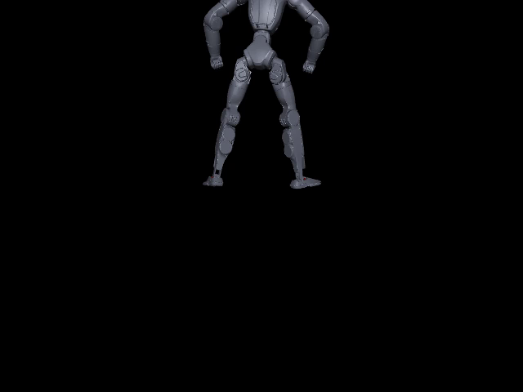
The divergence, captured
python sim2sim_r1_tennis.py
--- t=1100 (t_sec=8.800) --- action range: [-269.296, 262.766]
--- t=1200 (t_sec=9.600) --- action range: [-323.632, 319.253]
[RESULT] mean joint_pos_error: 8.8769 rad
[RESULT] max joint_pos_error: 16.0417 rad
[RESULT] final joint_pos_error: 16.0417 rad
Action magnitude growing into the hundreds is itself the tell -- a well-behaved policy, even one tracking poorly, doesn't do this. This is after the effort-limit fix; two further hypotheses were tested next (see next slide).
Plain-MuJoCo replay -- diverges after the initial correct frame

Slide 28
Sim2sim, continued
two more real tests, and where this actually lands
two follow-up tests, both real runs
Resumed r1_tennis_run1 from model_2999.pt -> trained to model_12998.pt (+10,000 iters)
Wall time: 3:19:10
Native evaluate.py, before -> after extended training:
success_rate 0.9688 -> 0.9844
mpkpe 0.2991 -> 0.1588 (nearly halved)
ee_pos_error 0.0870 -> 0.0679
sim2sim_r1_tennis.py, same checkpoints:
mean joint_pos_error 4.79 rad -> 4.59 rad (~4% better)
max joint_pos_error 9.02 rad -> 8.30 rad (~8% better)
Follow-up test -- swapped the harness's policy inference from
onnxruntime/CPU to the raw PyTorch checkpoint on CUDA (matching what
native training actually used):
mean joint_pos_error 4.70 rad (no meaningful change)
max joint_pos_error 8.27 rad (no meaningful change)
Neither test explains the gap. More training helps native performance a lot but barely moves sim2sim; matching the inference backend exactly (CUDA PyTorch, not CPU ONNX) makes no meaningful difference either.

Slide 29
Where this actually lands
Best-supported conclusion
Confirmed, in order: (1) 4 real bugs fixed. (2) Every observation term matches native's own
ground truth to floating-point precision -- the formula is provably correct. (3) Physics
agreement in open loop is real but not perfect: 0.38 rad mean error over 660 steps when
replaying native's own exact action sequence -- small, but not zero. (4) More training helps
native performance substantially (mpkpe nearly halved) but barely moves sim2sim (~4-8%) --
ruling out pure undertraining as the explanation. (5) Matching the inference backend exactly
(CUDA PyTorch vs CPU ONNX) makes no meaningful difference -- ruling out inference
non-determinism too.
What's left: a genuine, small physics-solver discrepancy between MuJoCo-Warp's GPU-parallel
contact solver and native MuJoCo's CPU solver -- not a bug in this harness, and not something
further tuning is likely to eliminate. A closed-loop bipedal controller's own corrections feed
back into its future observations, so even a small, bounded per-step physics difference
compounds over hundreds of steps. This is a known category of limitation for GPU-parallel
physics engines generally, not specific to this project's setup.

Slide 30
Next
A harsher sim2sim test would only make this gap worse, not better -- treat the current policy as not yet ready for real-hardware deployment on this evidence
Try training an architecture/training recipe known to be more robust to physics-engine differences (e.g. explicit domain randomization over solver-sensitive parameters)
Stance-aware ground pass refinement (flagged two weeks ago, still not required to train)
A third motion, further from tennis/dance in character (e.g. a fall recovery or a two-person interaction), to keep stress-testing how general this pipeline actually is

